Slide 1
Anatomy of the Pons
Presented by Omosola Tobi

Slide 2
Outline
Introduction to the Pons
Structures of the Pons
Vasculature of the pons
Clinical significance

Slide 3
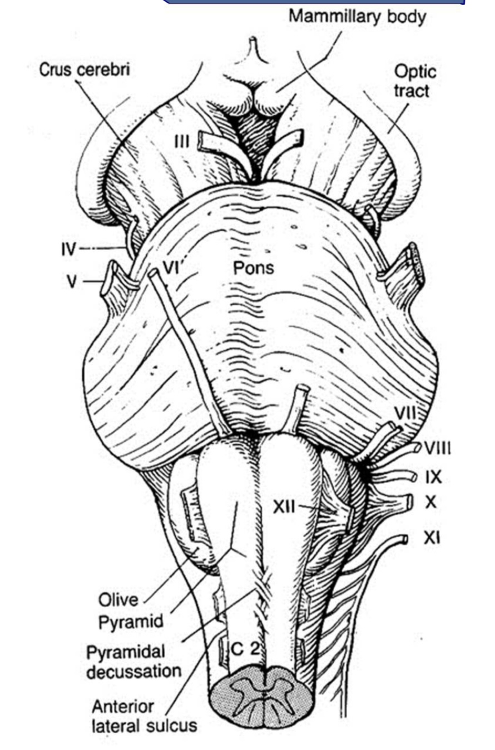
Introduction to the Pons
The pons is the middle part of
the brainstem, It is situated
between the medulla (below)
and midbrain(above), being
separated from them by the
inferior and superior pontine
fissures respectively.
The pons is about 2.5cm long,
located in the anterosuperior
part posterior cranial fossa.

Slide 4
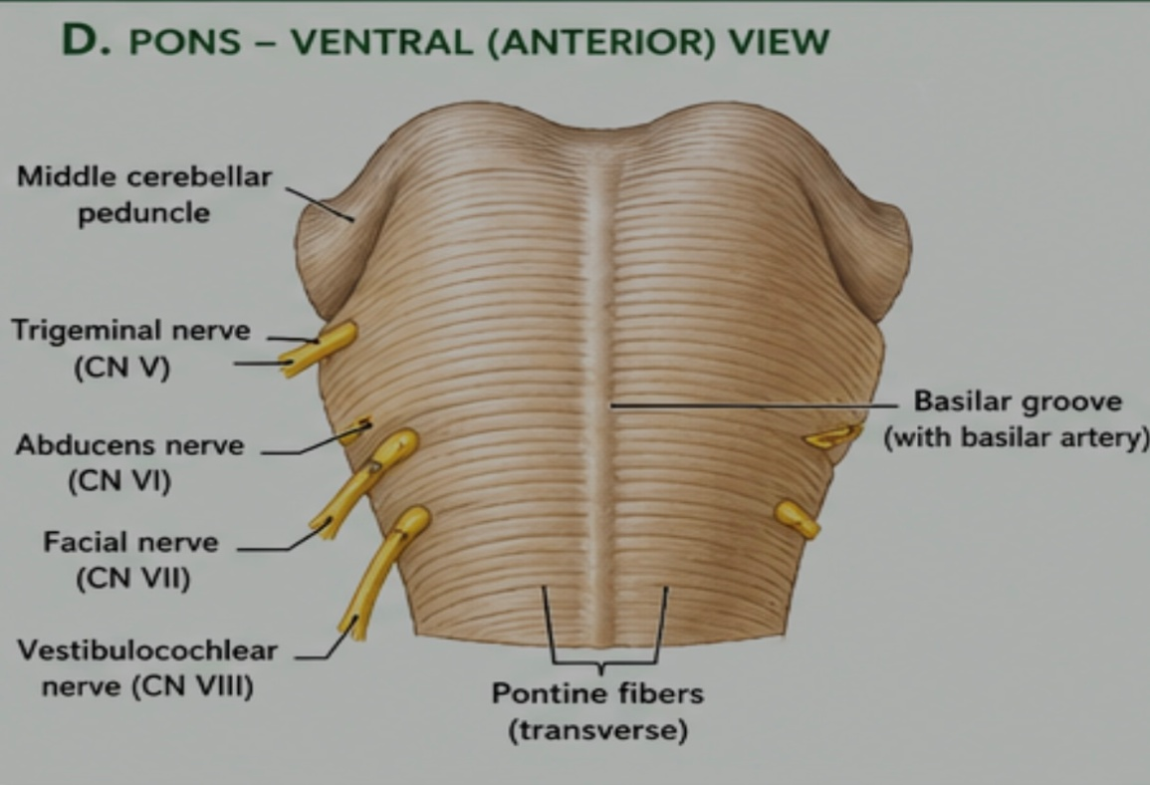
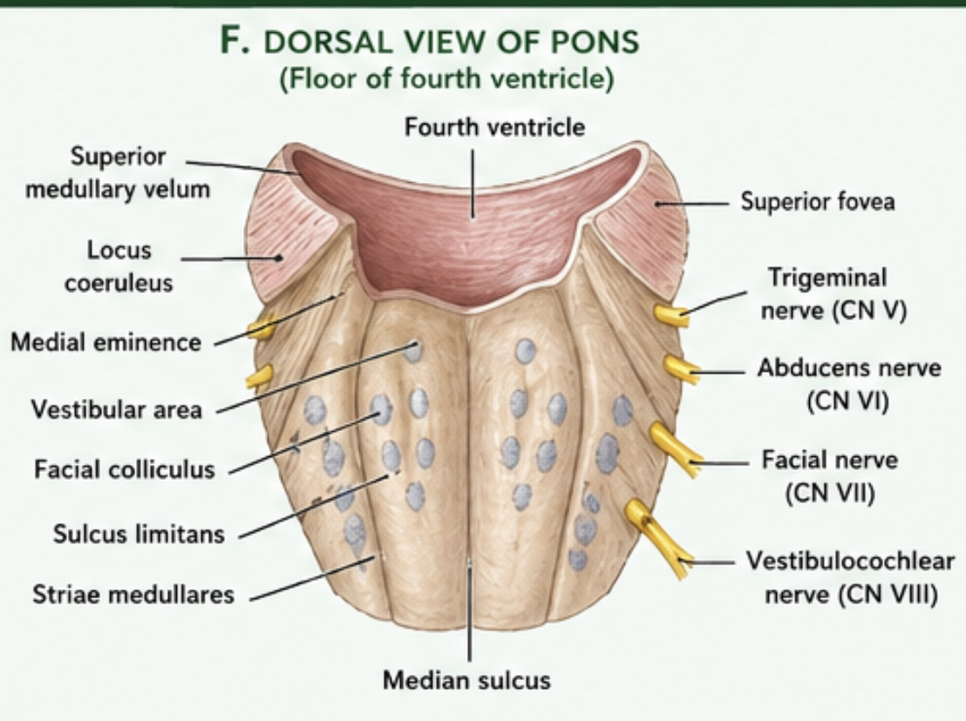
Intro cont’d
The anterior surface of
the pons has a shallow
vertical “basilar grove”
which lodges the basilar
artery.
The posterior surface of
the pons forms the
upper part of the floor
of the 4th ventricle and is
totally hidden in the roof of
the 4th ventricle.
This surface is roughly
triangular.

Slide 5
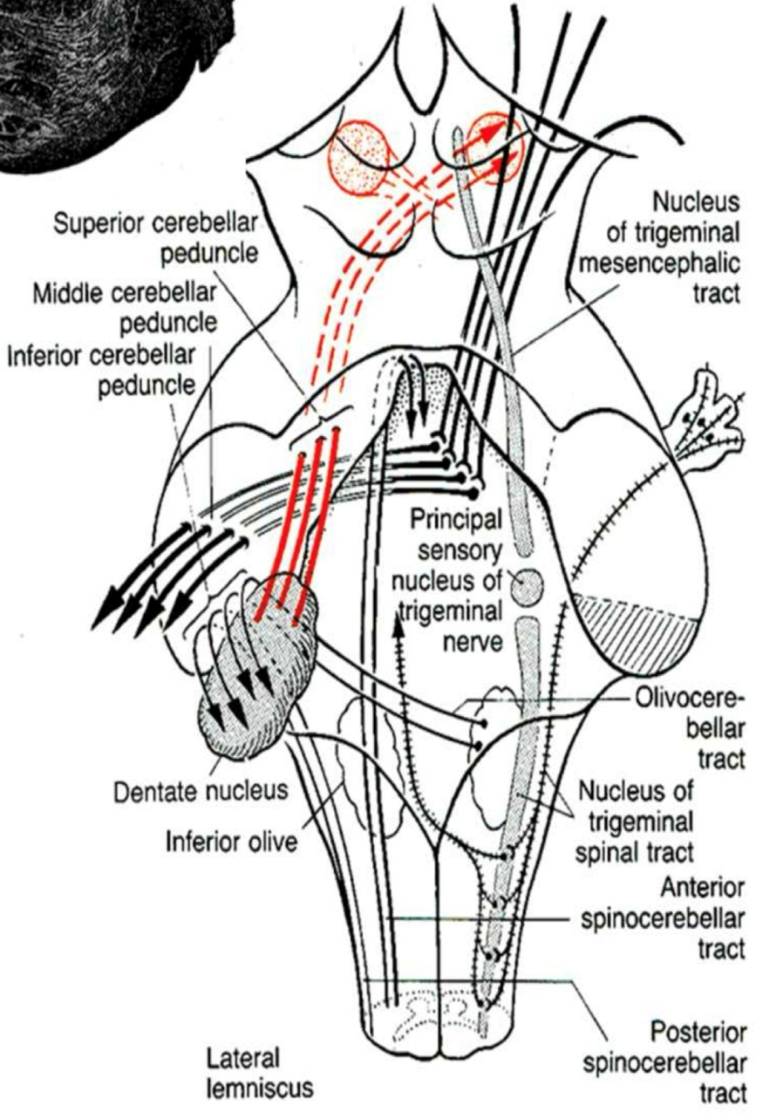
Structures of the pons
Internal structures
External structures
1. Internal structures: The pons is divided into the ventral and dorsal parts (the pontine tegmentum)
Ventral pons: this is the visible part of the pons. Its forms a rounded mass anteriorly that tapers into 2 middle cerebellar peduncles laterally.

Slide 6
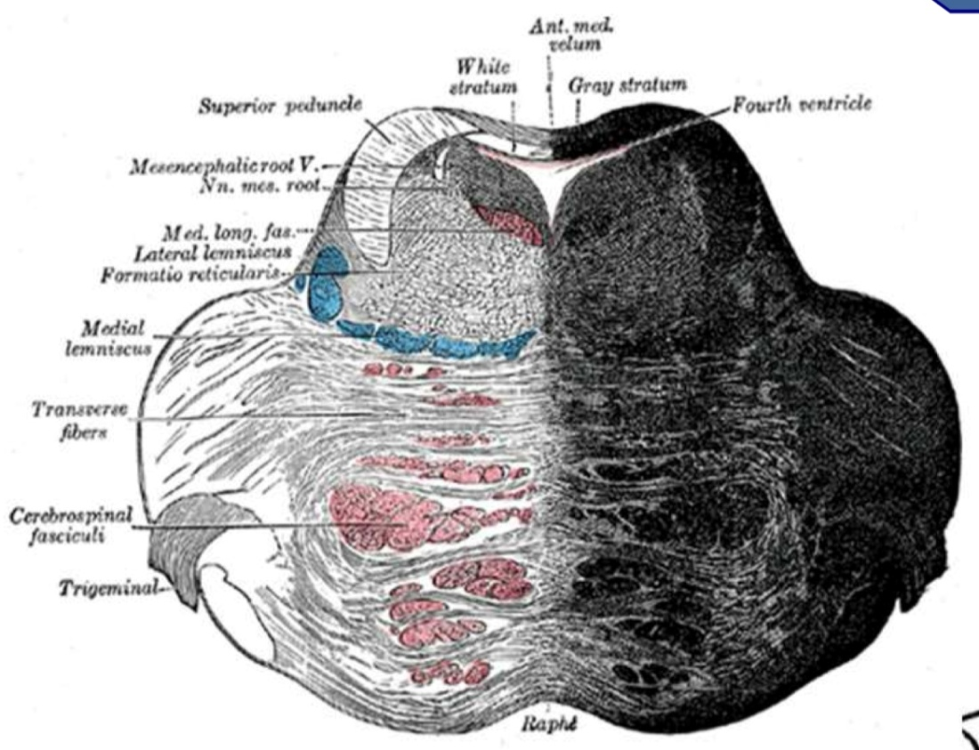
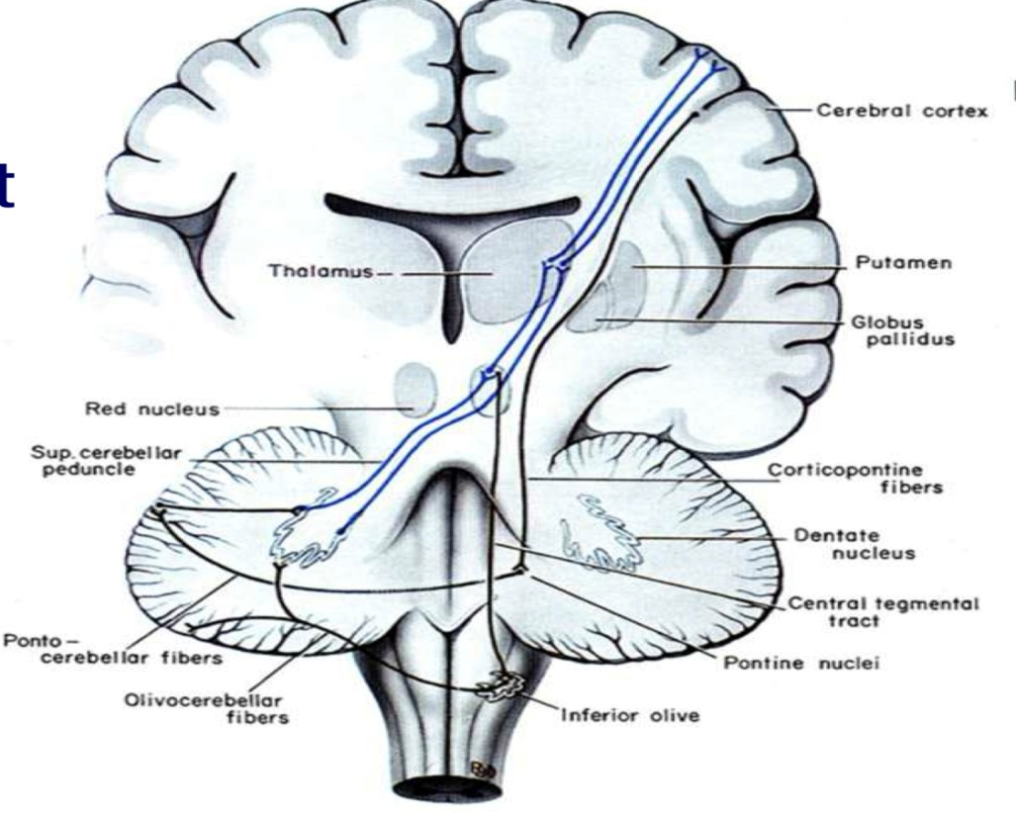
Ventral pons cont’d
The ventral pons consists of nerve
fibers & nuclei:
Pontine nuclei: a large number of small aggregations of neurons scattered throughout the ventral pons
Longitudinal fibers: originate from most of the cerebral cortex region, aggregate & descend in the cerebral peduncles of the midbrain to enter the pons. It divides into:
Corticospinal fibers
Corticonuclear fibers
Corticopontine fibers
Transverse fibers: originate from the pontine nuclei, cross midline to become contralateral middle cerebellar peduncles and enter the cerebellum.

Slide 7
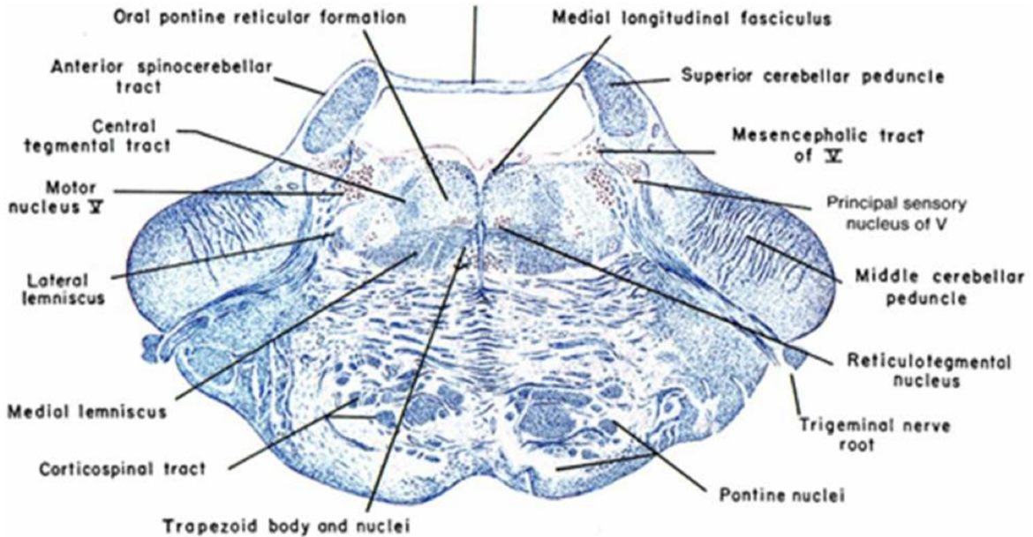
Dorsal Pons
This lies above the medulla, this
part contains the tracts
ascending from and descending
to the medulla (except
pyramidal tracts). It also
contains nuclei of some cranial
nerves and part of the reticular
formation
White matter:
Medial lemniscus: is the continuation of the gracile and cuneate tracts seen in the spinal cord and medulla.

Slide 8
Dorsal pons cont’d
Trigeminal lemniscus: a small tract originating from the contralateral spinal trigeminal nucleus & ascends to the thalamus
Lateral spinothalamic tract: ascends from medulla, it lies lateral to medial lemniscus
Lateral lemniscus: a small tract originating from the cochlear nuclei, ascends lateral to the lateral spinothalamic tract, to terminate in the inferior colliculus of the midbrain

Slide 9
Trapezoid body: a midline horizontal structure anterior to the medial lemnisci. It is made by the decussating fibers originating from the ventral cochlear nuclei and some small trapezoid nuclei
Medial longitudinal fasciculus: a small tract next to the midline beneath the floor of the 4th ventricle
Inferior cerebellar peduncles: bounds the lower part of pontine tegmentum posterolaterally
Superior cerebellar peduncles: bound the upper part of pontine tegmentum posterolaterally

Slide 10
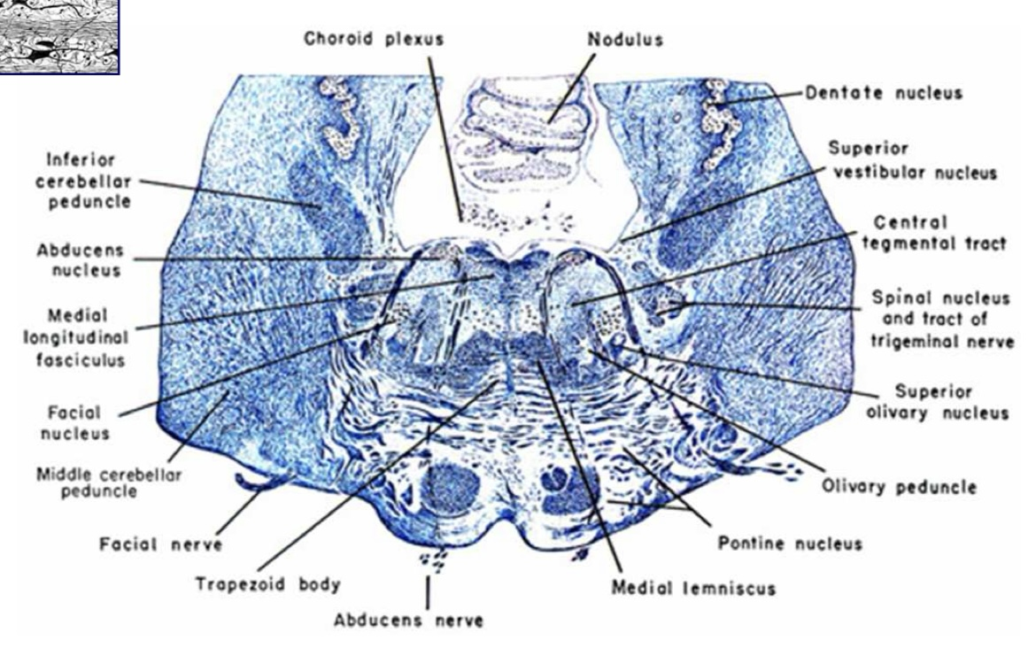
Gray matter:
Cranial nerve nuclei:
Vestibular nuclei: It contains 4 large nuclei situate beneath the floor of the 4th ventricle, occupying most of the lateral part of the floor
Cochlear nuclei: 2 small nuclei, situated ventral and dorsal to the inferior cerebellar peduncle respectively
Facial nerve nuclei: the main nucleus of the facial nerve is situated in the lower part of the pontine tegmentum
Special visceral afferent (SVA)
General viscera afferent (GVA)
General somatic afferent (GSA)

Slide 11
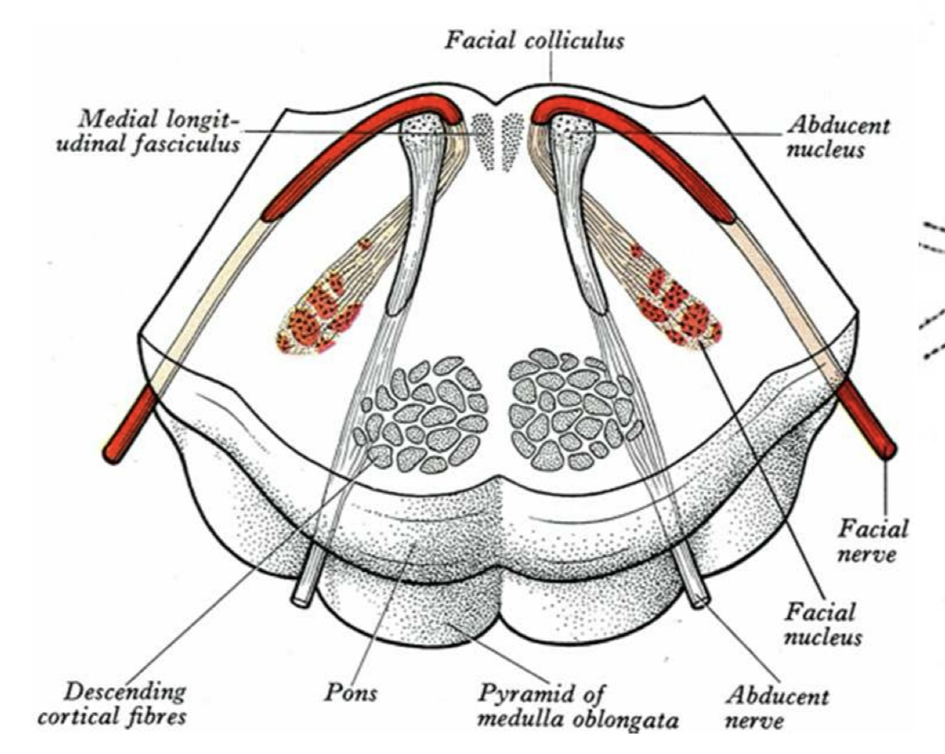
Gray matter cont’d
3. Abducens nucleus: small motor nucleus situated next to the midline beneath the floor of the 4th ventricle, in a level slightly superior to the facial nucleus
4. Trigeminal nuclei: 4 large nuclei situated in a plain lateral to the facial nuclei. They are:
Motor nucleus (SVE)
Principal sensory nucleus
Spinal nucleus (GSA)
Mesencephalic nucleus

Slide 12
B. Specific nuclei:
Nuclei of trapezoid body: a group of small nuclei situated around the midline within the decussation of fibers coming from the ventral cochlear nuclei
Nuclei of lateral lemniscus: small nuclei situated within the lateral lemniscus
C. Reticular formation: pontine reticular formation is continous with reticular formation in the midbrain & medulla. It is more extensive than that of the medulla. It occupies the central region of the pontine tegmentum on both sides of the midline

Slide 13
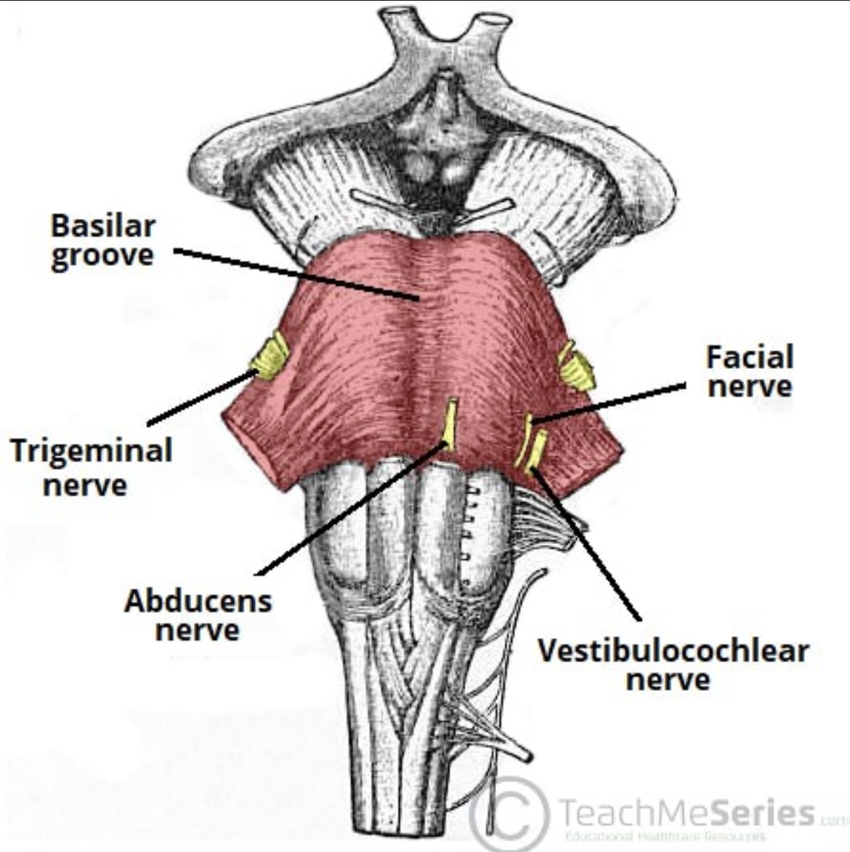
External structures
Anterior surface: is marked by a bulging formed by the transverse pontocerebellar fibres.
The basilar groove demarcates the
midline of the ventral surface and is where
basilar artery is located.
The pontomedullary junction is defined by
the angle between the lower border of the
pons and the superior border of the
Medulla.
Several cranial nerves originate here:
Cranial nerve V (Trigeminal)
Cranial nerve VI (Abducens)
Cranial nerve VII (Facial)
Cranial nerve VIII (Vestibulocochlear)

Slide 14
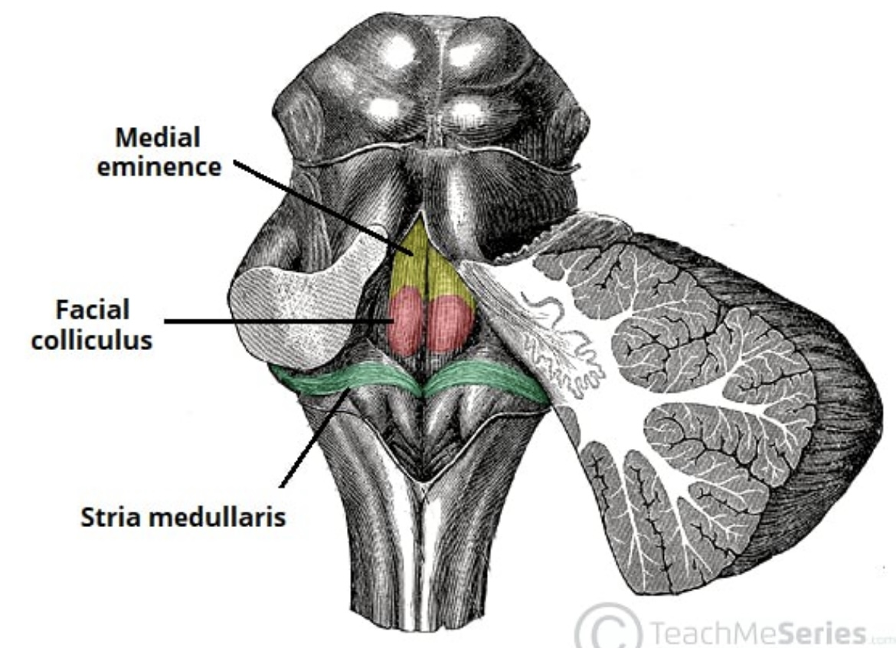
2. Posterior surface
The floor of the 4th ventricle
is composed of the dorsal
surface of the pons and
medulla.
Anatomical landmarks:
Medial eminence: marks the midline of the floor
Facial colliculus: a bulging formed by fibres of facial nerve looping around the abducens nucleus
Stria medullaris of 4th ventricle: a bundle of nerve fibres crossin transversely from the lateral aspect into the midline

Slide 15
Vasculature of the Pons
The blood supply of pons is formed by branches
of the vertebrobasilar system:
Most of the pons is supplied by pontine arteries, branches of the basilar artery
A smaller part of its blood supply comes from the anterior inferior cerebellar artery (AICA) and the superior cerebellar artery (SCA)
The venous drainage to the pons consists of the anterior
pontomesencephalic vein, which drains into the basal vein,
that in turn drains into the cerebral veins.
Inferiorly, the pons drain into the inferior petrosal sinus,
which drains into the internal jugular veins.

Slide 16
Clinical significance
Cerebellopontine angle syndrome: The cerebellopontine angle is an often site for intracranial growths, which can lead to impairments of nearby structures e,g CN VIII
Vestibular schwannomas

Slide 17

THANKS FOR LISTENING

